Slide 1
DINO GAME USING HAND GESTURE RECOGNITION
Skandan K A PES2201800064
Natakala Harshit PES2201800079
V Mahendra Varma PES2201800661

Slide 2
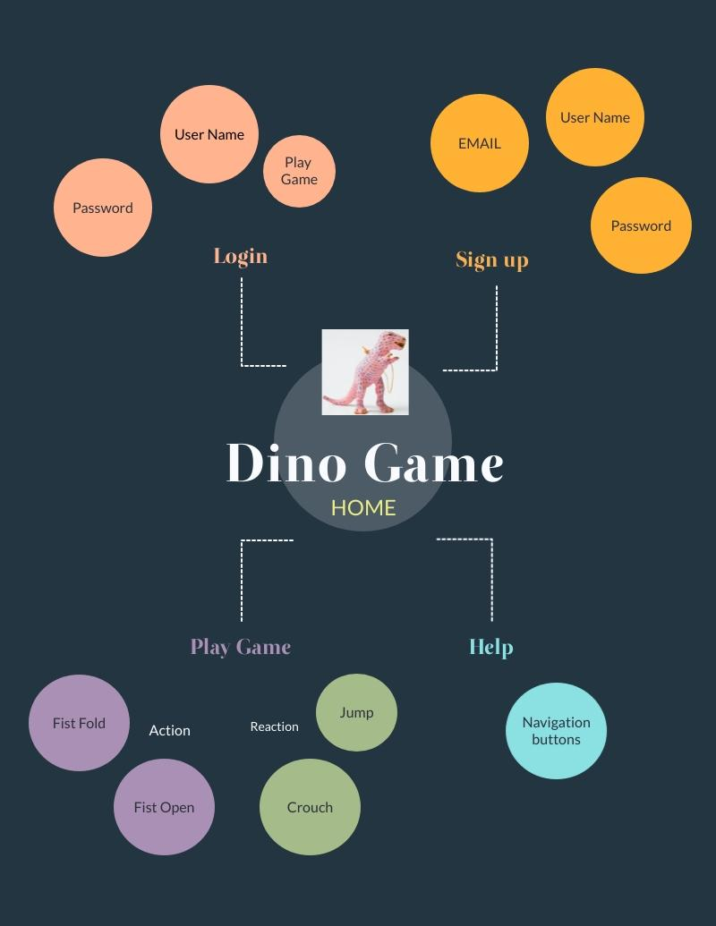
CONCEPT MAP

Slide 3
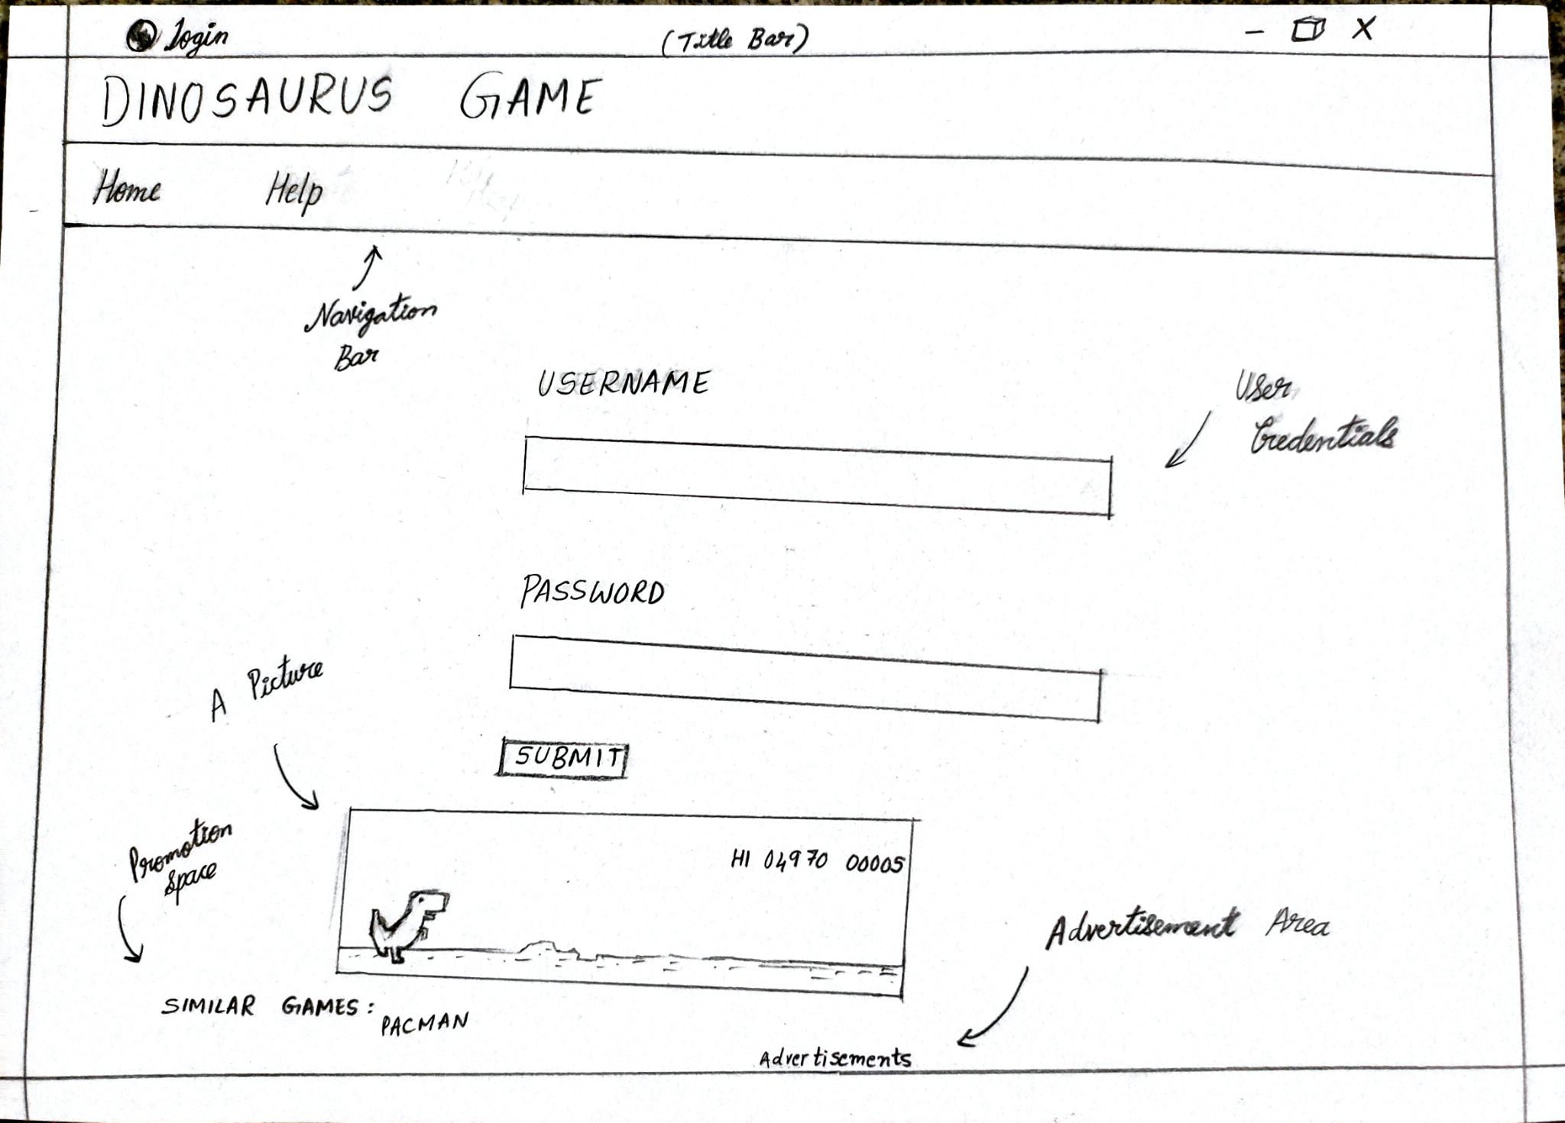
Login Page Asks users to give their Username and passwords.
Navigation bar has the buttons for travelling between the pages.
Promotion and Advertisement Spaces are given at the end.
LOGIN

Slide 4
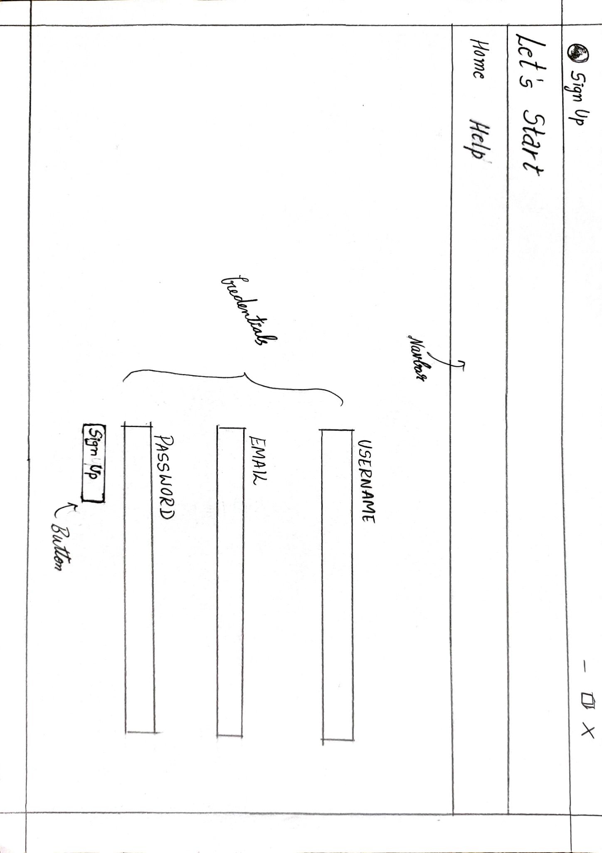
New Users should signup using Name,Email and password at the start.
Navigation bar remains the same as previous.
Signup button should be used at the end.
SIGN UP

Slide 5
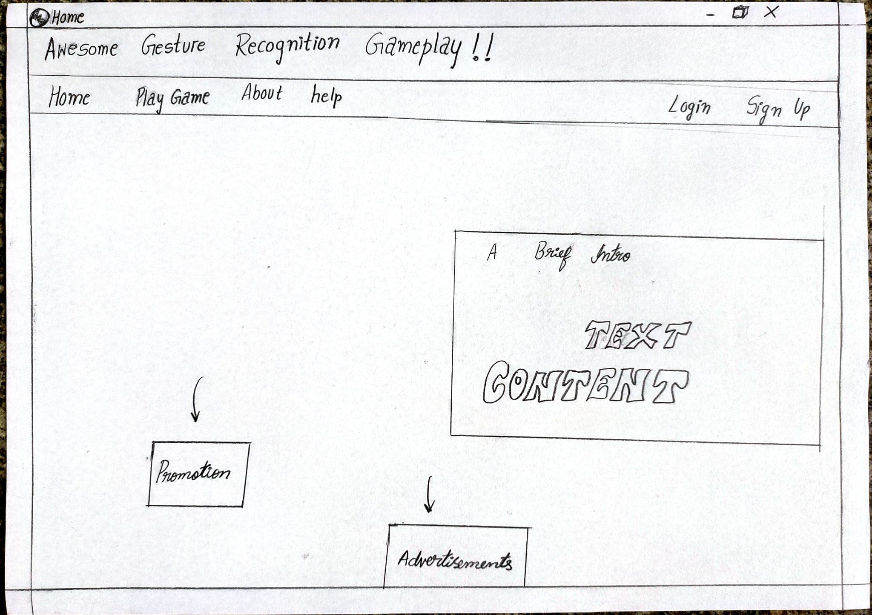
Home has a brief introduction about the website.
Play Game takes the user to the Game Arena.
Promotion and Advertisement Spaces are given at the end as before.
HOME

Slide 6
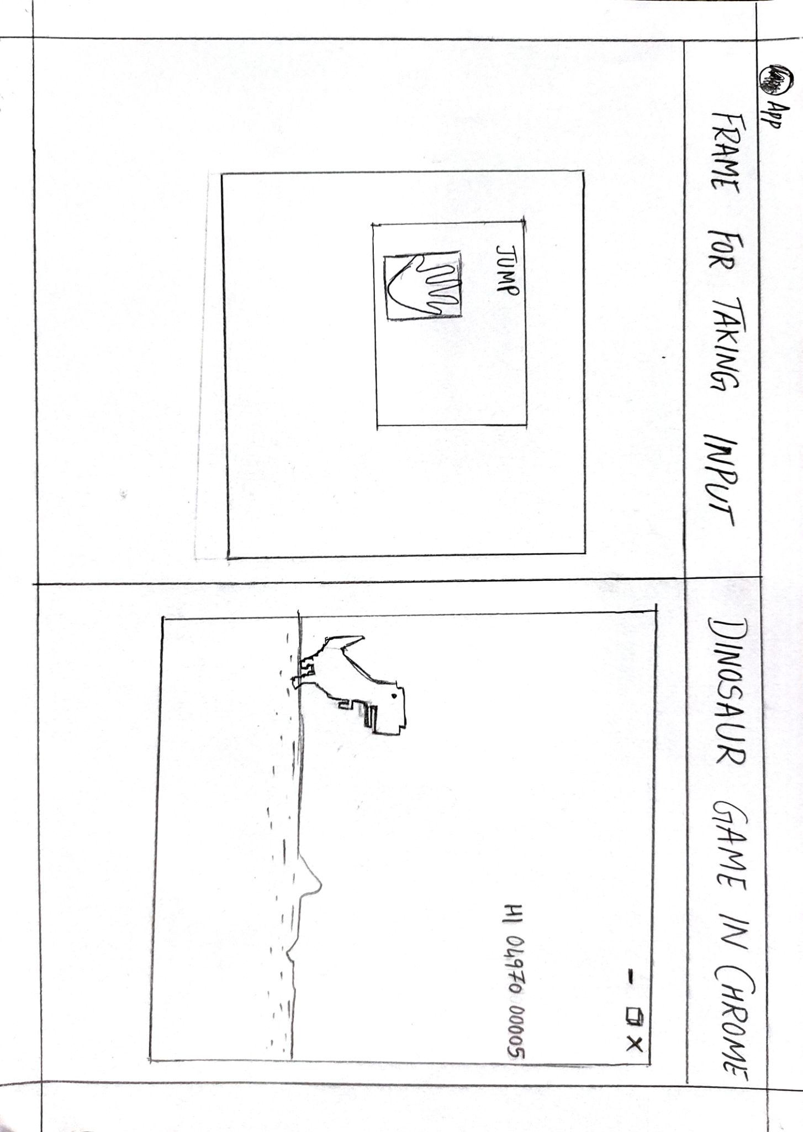
There would be 2 windows side by side- One would be the Gesture Recognition Frame(webcam would be on) and other, the Chrome tab running the game.
Open Fist commands the dinosaur to Jump and Close fist to crouch
The User Can keep Playing till he gets Exhausted😄
PLAY TIME!!

Slide 7
EMPATHY MAP
SAYS I go to gaming lounge with my friends to play virtual reality games But I’m scared to go there because of the pandemic | THINKS I wish there were alternatives to play a game through gaming consoles.
DOES Just play multiplayer games online with friends from home I Play FIFA in my friend’s PlayStation | FEELS I feel its not safe to visit any gaming lounge at least until the pandemic is over.

Slide 8
EMPATHY MAP
SAYS I don’t want to share my controller with anyone because of the current situation I participated in few online gaming tournaments | THINKS I wish there could be a game that does not require any direct contact Like which recognizes our physical movements, gestures .
DOES I try to carry a sanitizer with me, to sanitize the things. If I forgot the sanitizer , then I just watch my friends play. | FEELS Sharing gaming controllers is infectious .

Slide 9
HEURISTIC EVALUATION
Using Shneiderman's Eight Golden Rules

Slide 10
1. Strive for Consistency
In similar cases, consistent action sequences should be required; identical terminology should be used in prompts, menus, and help screens; and consistent commands should be used throughout.
All of the application's pages have a clear user interface.
The use of similar words in the menu aids navigation between all of the pages.
Eg: Navigation Buttons Like Help,Home can be seen in all the pages.

Slide 11
2. Enable frequent users to use shortcuts
As the usage frequency increases, the user wishes to decrease the number and pace of interaction. Shortcuts, function keys, hidden commands and macro equipment are very helpful to an experienced user.
Once a user has logged in, he will remain logged in until he exits the application. In addition to clicking on the login button, the keyboard key (ENTER) or Mouse Click can be used to confirm the login credentials and email confirmation for use of the application.

Slide 12
3. Offer informative feedback
There should be some system feedback for every operator action. The response to frequent and minor actions can be modest, whereas the response to infrequent and major actions should be more substantial.
Error messages (no error codes) are expressed in plain language, indicating the problem precisely and propose a solution.
Eg: Sometimes we’ll directly get the HTML code when the loading hasn't happened properly instead of getting the wait message.

Slide 13
4. Design dialog to yield closure
Action sequences should be organised as starting, middle and end groups. The informative feedback on the completion of the action group provides operators with the satisfaction of performance, a sense of relief, a signal that contingency plans and options are dropped from their minds and a clear way forward for the next action group to be prepared.
During credential/e-mail confirmations, dialogue boxes are used to show custom successes or failures

Slide 14
5. Offer simple error handling
The Interface should be designed in a very easy to use manner to avoid confusing the user.
It should be made sure that some response is given out when an error is detected.
In our case, when the user dosen’t perform the input actions within the frame, a pop up can be shown in the website.
A prompt can be made, if the user is very far from the camera.

Slide 15
6. Permit easy reversal of actions
This feature alleviates anxiety by letting the user know that mistakes can be reversed, thus encouraging the exploration of unfamiliar options.
Reversibility should be made easy to implement with the help of button clicks, refresh etc..
In our website, if he goes to a wrong page, with the help of navigation buttons, he can correct his path easily.
If he enters wrong credentials, he can just refresh and enter the correct ones.

Slide 16
7. Support internal locus of control
According to this, the users should be the main reason for the cause of actions, instead of them just interacting in a passive manner.
Users will be given full control to play the game, once the credentials are verified.
The game mainly spins around the users actions which would be responsible either for their win or a loss.

Slide 17
8. Reduce short-term memory load
According to this, the user should not be compelled to remember much information while navigating between the tabs, which would be necessary for the usage of upcoming tabs. So the websites should be very simple in nature with minimum complexity.
In this website,The users just need to give their credentials, making the job simple.
No information is required to be remembered in between Tab navigation.

